Slide 1
COMP 2615
Exercise 1 – Analysis
Catriona Campbell
Darcy Ulmer
Paul Lau

Slide 2
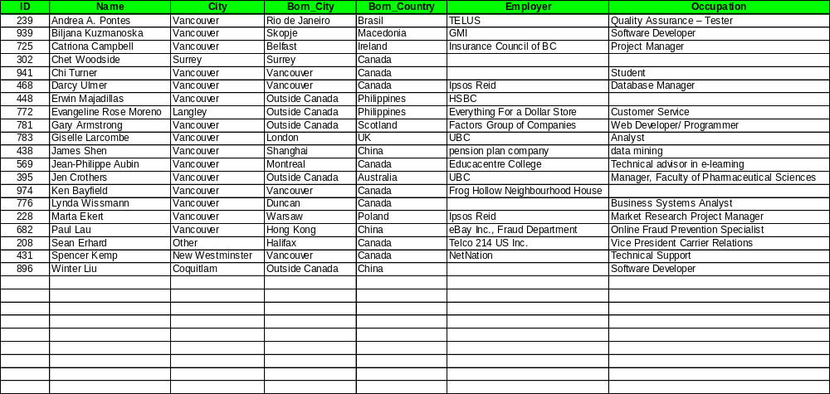
Class Data

Slide 3
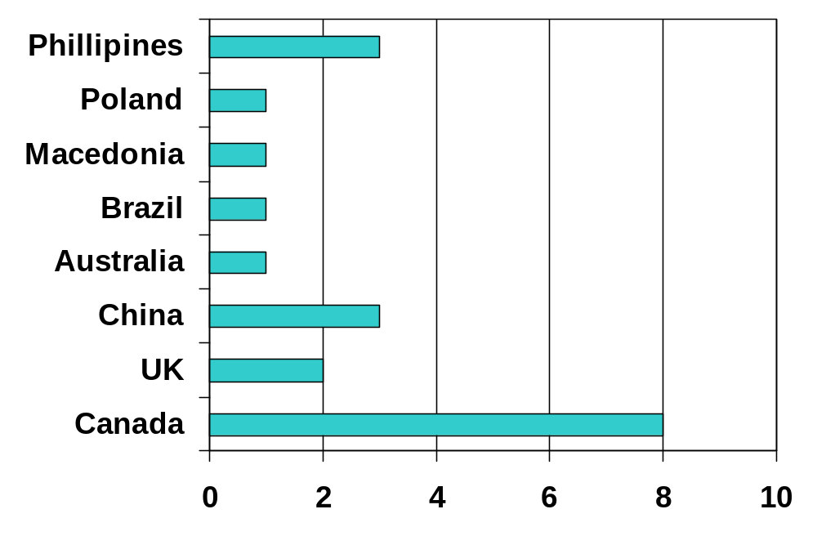
Country of Birth

Slide 4
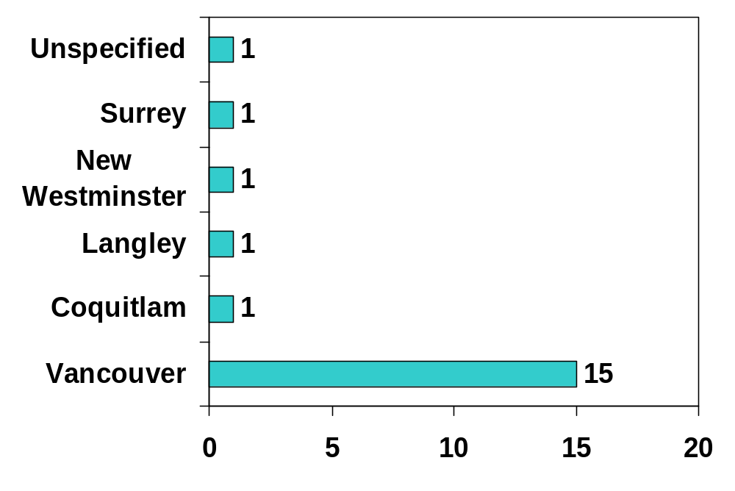
City of Residence

Slide 5
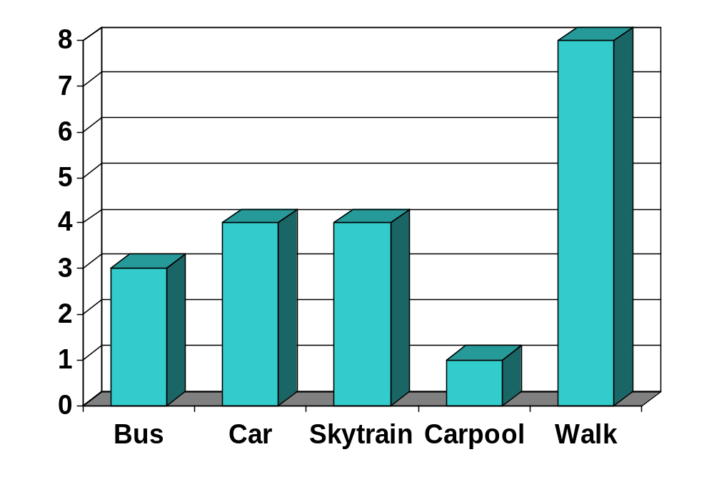
Commute

Slide 6
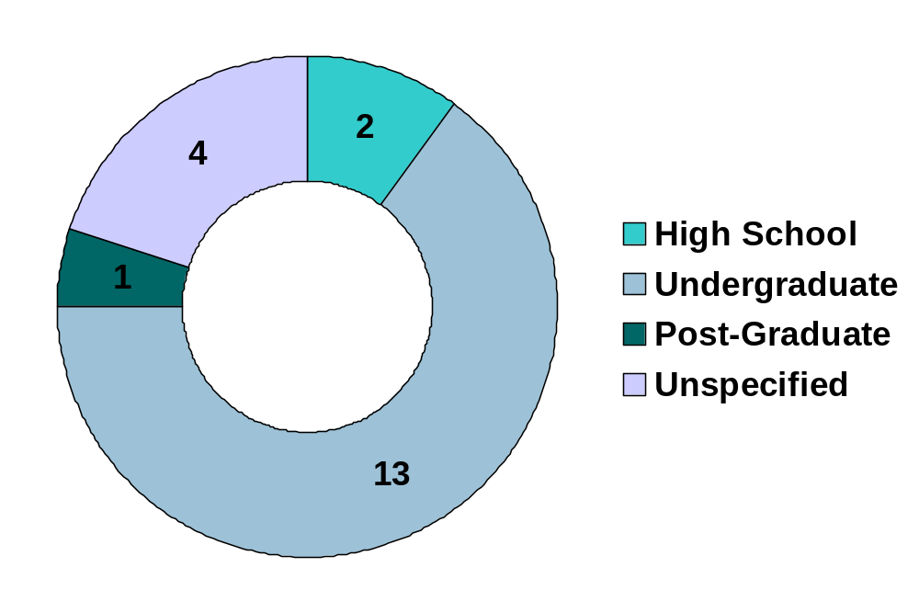
Education – Level

Slide 7
Education – Discipline
Marketing
Management
Business
Information Technology
Law
Economics
Operations Research
Classical Animation

Slide 8
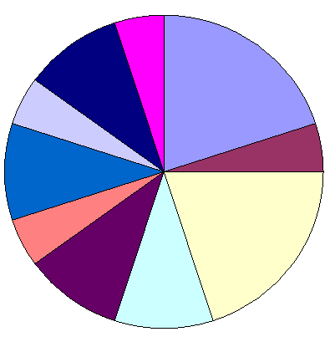
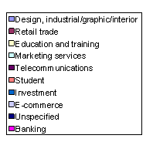
Industry
Industry Category By Nature of Employer

Slide 9
Industry
Since we are all enrolled in COMP2615, it is reasonable to assume that many of us are planning on a career path as a Systems Analyst, or something similar.
System Analysts are needed in all kinds of industries, so it’s interesting to see what industry our current employers belong to.
To be consistent with the definition of industrial categories, information is taken from Industry Canada:
  http://strategis.ic.gc.ca/epic/site/ic-ic.nsf/en/home

Slide 10
Interests
Sports (8) | Snowboarding, soccer, basketball, cycling, swimming, martial arts, running.
Arts & Entertainment (5) | Music, movies, reading, photography
Traveling (4)
Web/ Technology (4) | Web design, eBay, gadgets
Other | Dog training, Bible teacher, sleeping, trading, puzzles

Slide 11
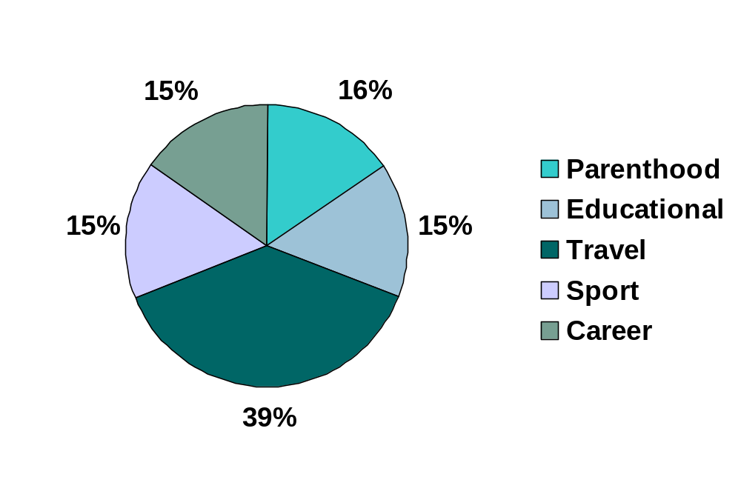
Achievements

